Slide 1
VR in Tourism
Group No. 27
Satyarth Pandey (106119112)
Rajneesh Pandey (106119100)
Nikhil Murari (106119084)
Aman Anand (106119010)

Slide 2
Problem Statement
Due to travel restrictions around the world, Global Tourism came to a halt, but the urge to travel didn’t.
We addressed this Problem by using Virtual Reality in the field of Tourism (Unity 3D).
One of the greatest strengths of VR is allowing the user to experience the feeling of “being there”. Whilst regular images and videos can work well for showing what a destination has to offer, they don’t often elicit an emotional response.

Slide 3
VR technology in tourism
VR can be used in many different ways in the tourism industry. The technology is evolving at a rapid rate and the uses of VR within tourism is expanding along with the technology.
The main VR technologies that are used in the travel industry are VR tourism videos/photography

Slide 4
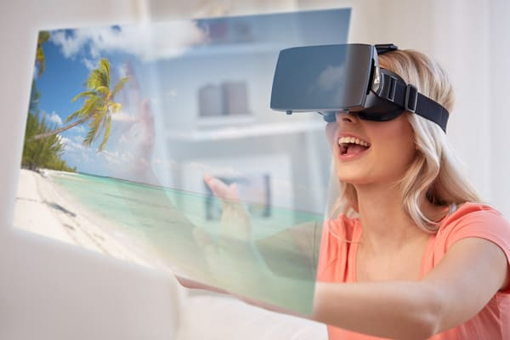
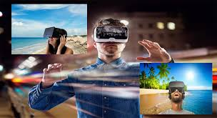

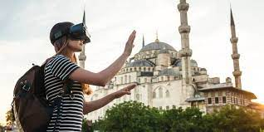

Slide 5
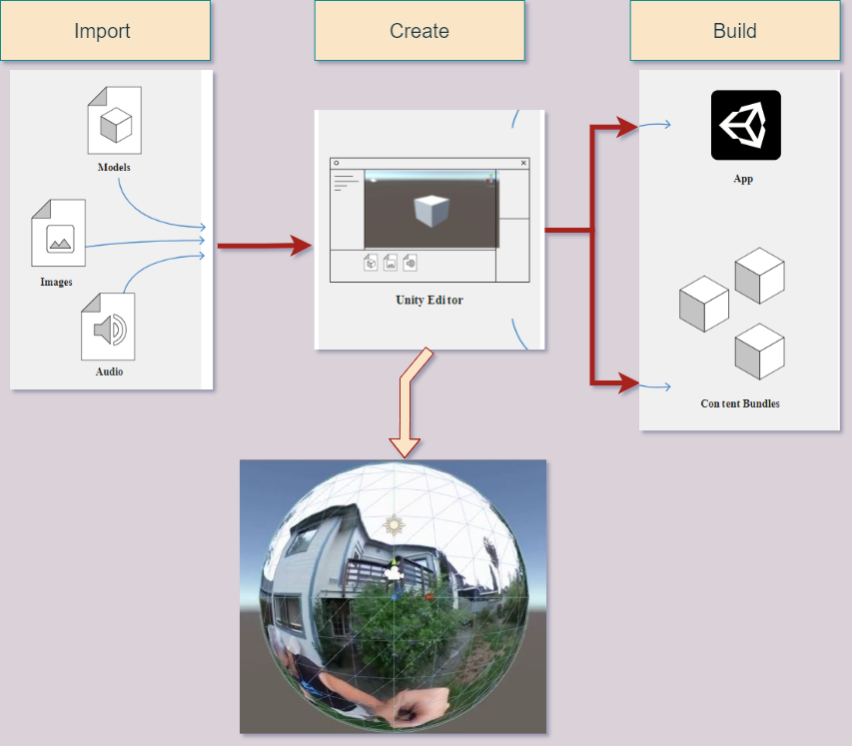
Block
Diagram

Slide 6
Tools Used
Software: Unity 3D, VS Code, GitHub
Programming language: C# (mostly), ShaderLab (HLSL)
Packages : Unity Assets
We Used Photospheres for the virtual reality and also 3D Model Prefabs in it.

Slide 7


